Slide 1

Tactile Sensor
By Jiayi Yuan & Qiuhao Ma

Slide 2
Tactile Sensor
Square FSR
1. Resolution 2. Dynamic range 3. Sensitivity
Long Flex/Bend Sensor
1. Sensitivity 2. Dynamic range
Circular Soft Potentiometer
1. Accuracy 2. Linearity

Slide 3
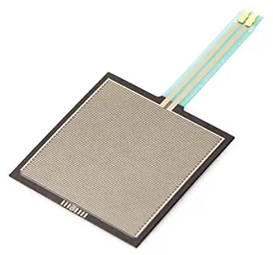
Square FSR
FSRs are sensors that allow you to detect physical pressure, squeezing and weight. FSRs are basically a resistor that changes its resistive value (in ohms Ω) depending on how much its pressed. Note that this sensor can't detect where on the square you pressed.

Slide 4
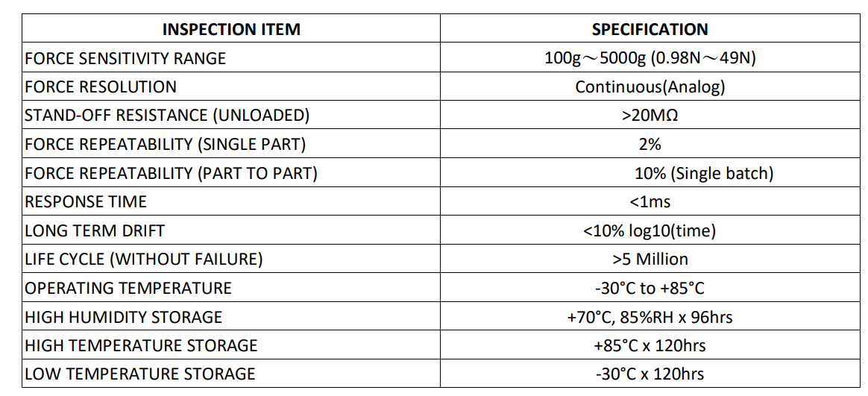
Data sheet

Slide 5
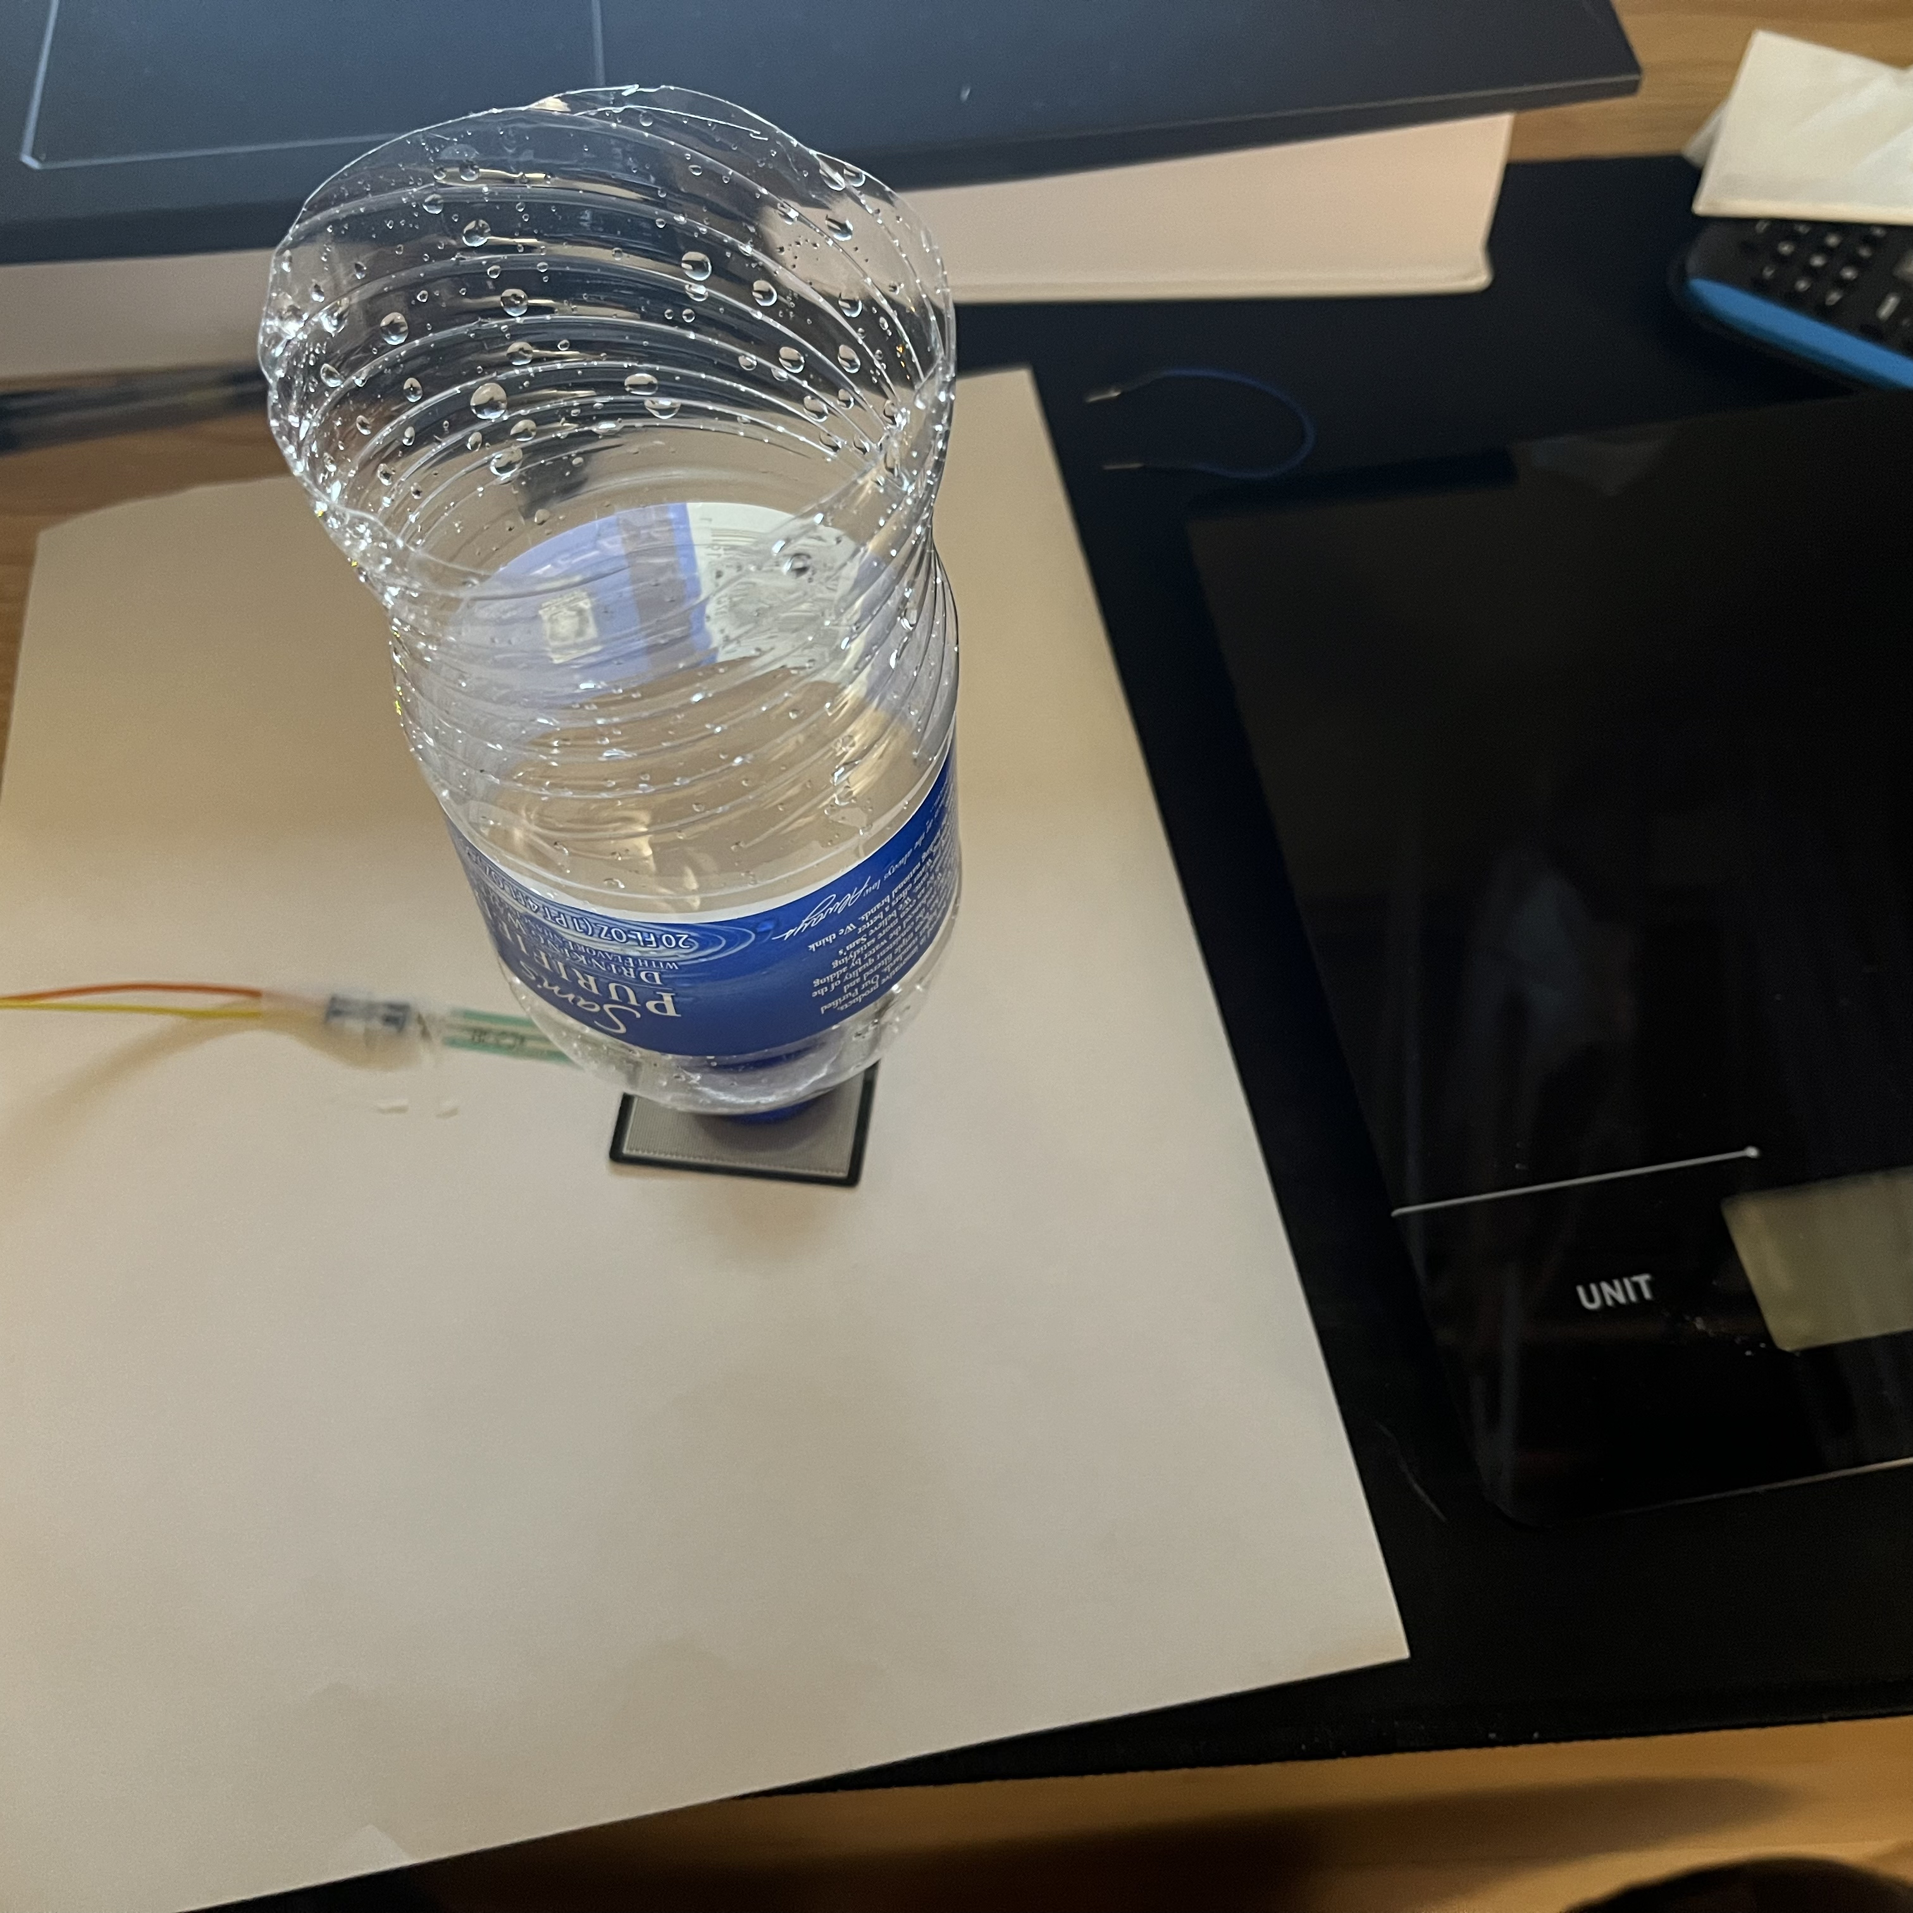
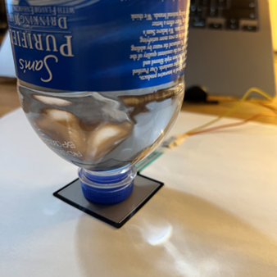
Testing plan
Resolution: To test this, we design to adding water into an empty bottle and increase the weight a little at a time, in other words, to use gravity as pressure, to test how much pressure is required each time to make the sensor sense the pressure change.
Equipment: A Kitchen Scale, empty bottle and water.

Slide 6
Resolution
Square
Weight(g) | 1 | 2 | 3 | Average Measurement(g) | Error | Resolution | Resolution
112 | 112.29 | 111.76 | 115.36 | 113.14 | 1.01% |  | 4.77066667
118 | 113.14 | 110.79 | 118.45 | 114.13 | -3.28% | 0.99
120 | 115.51 | 114.72 | 115.51 | 115.25 | -3.96% | 1.12
125 | 117.89 | 117.09 | 116.3 | 117.09 | -6.33% | 1.85
126 | 121.08 | 120.28 | 121.08 | 120.81 | -4.12% | 3.72
128 | 136.06 | 138.29 | 136.62 | 136.99 | 7.02% | 16.18
The reference resolution is “continuous” which means infinitely small.
Notes:
Slowly add water to the bottle until the data changes. And we need to wait the data to be stable.
When the mass of the object is small, the sensor does not seem to be very sensitive, so the data will change only when a lot of water is added each time.
We only choose the data after 100g because we can not measure the data accurately before the mass becomes larger.
We all know that the resolution is the minimum increment in stimulus to which a sensor can respond. Ideally, there is no difference between the actual mass and the measured mass, so the resolution is infinitely small.
And we get the resolution of the initial data is 4.7707. which is much bigger than infinitely small.
This means that the larger the weight is, the larger the data of the sensor will be.

Slide 7
Testing plan
Dynamic range: We design to use different weight objects to test the minimum weight or pressure that can change the sensor value. And the maximum weight or pressure value that the sensor can sensed.
Equipment: A Kitchen Scale, different weight objects.

Slide 8
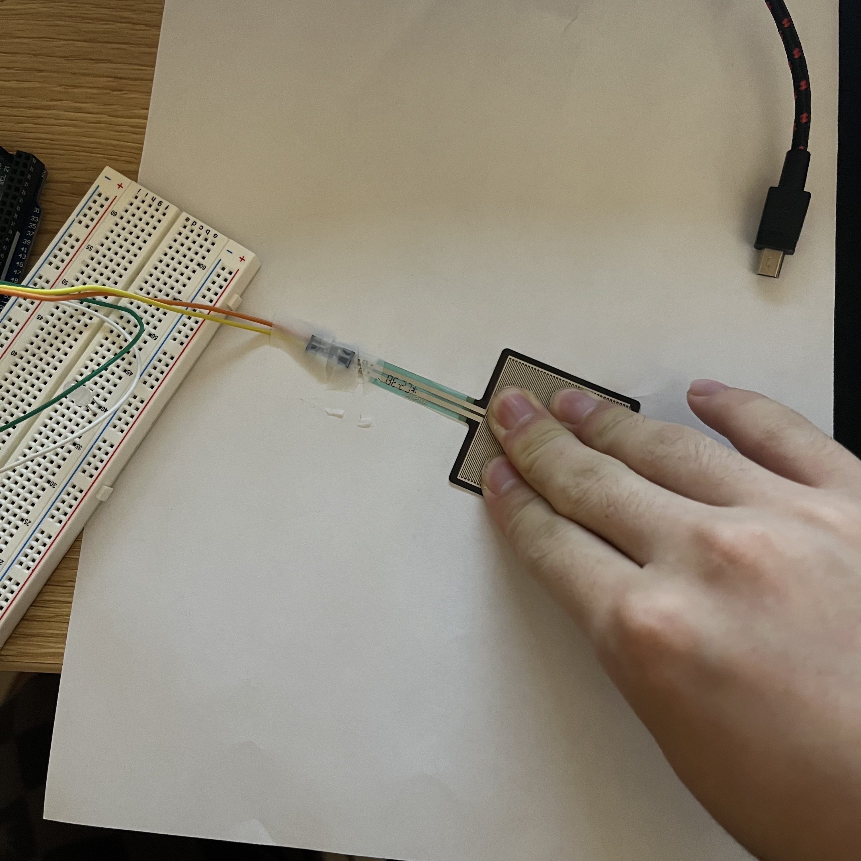
Dynamic range
The testing range:
The maximum is 45143.52g
The minimum is 0.76g
The reference range is 100g – 50000g
Notes:
Our minimum force measured is 0.76g, which is basically the same number for objects with very small mass, or there is no data directly.
The largest data we can measure is 45143.52g, which is the result of almost the whole person pressing on the sensor. I really can't measure data larger than this.
I think the reason why there is no range below 100g may be that the weight of the object is too small, and the resistance value of the sensor is too large, resulting in the current is too small to measure accurately.

Slide 9
Testing plan
Sensitivity: Sensitivity in this sensor is defined as the change in measure weight for a given change in actual weight. We design to calculate the slope.
Equipment: Arduino, calculator.

Slide 10
Sensitivity
Square
Weight(g) | 1 | 2 | 3 | Average Measurement(g) | Error | Sensitivity
12 | 2.29 | 0.76 | 5.36 | 2.80 | -76.64% | 0.23
20 | 15.51 | 14.72 | 15.51 | 15.25 | -23.77% | 1.56
25 | 17.89 | 17.09 | 16.3 | 17.09 | -31.63% | 0.37
26 | 21.08 | 20.28 | 21.08 | 20.81 | -19.95% | 3.72
27 | 17.09 | 17.89 | 17.09 | 17.36 | -35.72% | -3.46
62 | 25.11 | 25.93 | 25.93 | 25.66 | -58.62% | 0.24
97 | 111.24 | 109.25 | 110.24 | 110.24 | 13.65% | 2.42
176 | 258.25 | 260.95 | 259.6 | 259.60 | 47.50% | 1.89
357 | 535.2 | 537.37 | 539.55 | 537.37 | 50.52% | 1.53
687 | 1052.24 | 1006.23 | 1002.24 | 1020.24 | 48.51% | 1.46
The reference sensitivity is 1.
Notes:
Although the sensor range starts at 100g, I still select some data below 100g for analysis.
It is proved that the sensitivity of data after 100g is closer to 1 than that before 100g, which means that the data after 100g is more accurate. Therefore, it is better to measure objects above 100g with this sensor.

Slide 11
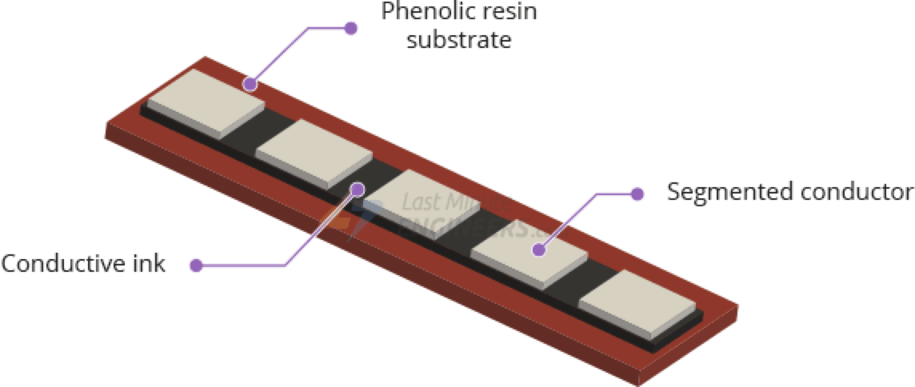
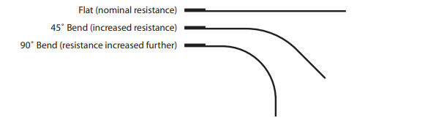
Long Flex/Bend Sensor
This sensor can detect flexing or bending in one direction.
They are basically resistors that change value based on how much they're flexed.
As the sensor is flexed, the resistance across the sensor increases.

Slide 12
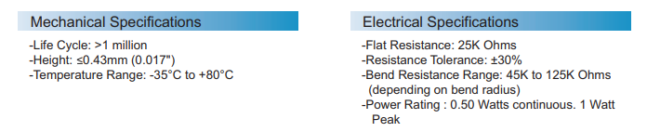
Data sheet

Slide 13
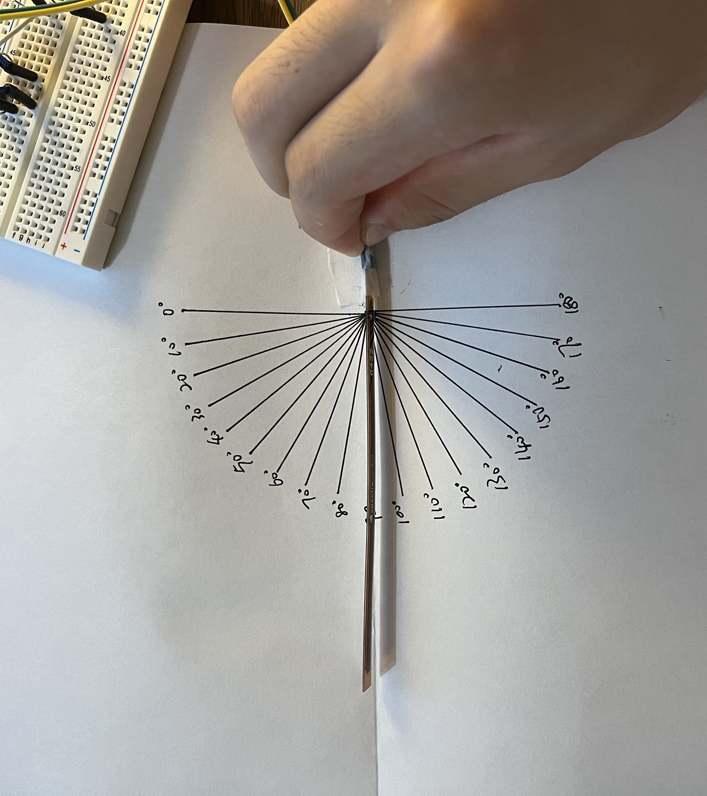
Testing plan
Dynamic range: To find the minimum angle of bend that can be sensed by this sensor, and the maximum angle of bend that can sensed by this sensor.
Equipment: protractor

Slide 14
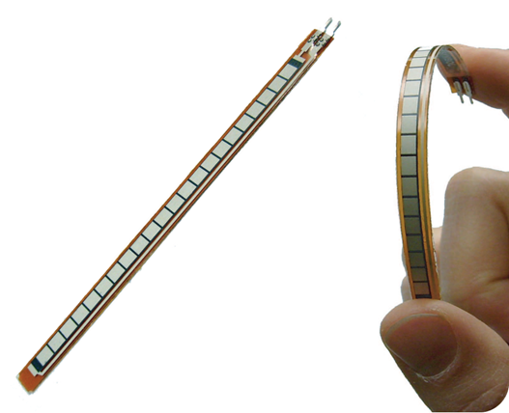
Dynamic range
The maximum is 255°
The minimum is 4°
Notes:
We measured a maximum of 255 and a minimum of 4.
We spent a lot of time trying to find the minimum 0, but we didn't find it.
I think the error is caused by the damage caused by the bending of the sensor for many times.

Slide 15
Testing plan
Sensitivity: We design to calculate the slope of the image
Equipment: Arduino, calculator.

Slide 16
Sensitivity
Long
Bending Angle(º) | 1 | 2 | 3 | Average Measurement(º) | Error | Sensitivity
30 | 248 | 241 | 255 | 248.00 | 726.67% | 8.26666667
40 | 13 | 49 | 42 | 34.67 | -13.33% | -21.333333
50 | 42 | 53 | 42 | 45.67 | -8.67% | 1.1
60 | 49 | 57 | 64 | 56.67 | -5.56% | 1.1
70 | 64 | 57 | 64 | 61.67 | -11.90% | 0.5
80 | 79 | 86 | 71 | 78.67 | -1.67% | 1.7
90 | 101 | 109 | 101 | 103.67 | 15.19% | 2.5
100 | 103 | 110 | 111 | 108.00 | 8.00% | 0.43333333
110 | 120 | 137 | 146 | 134.33 | 22.12% | 2.63333333
120 | 233 | 225 | 225 | 227.67 | 89.72% | 9.33333333
130 | 164 | 137 | 111 | 137.33 | 5.64% | -9.0333333
The reference sensitivity is 1
Notes:
We tested the data from 30 degrees to 130 degrees. From the data in the table, we can see that when the Angle is very small and the Angle is very large, the measured data is not very stable and accurate. I think the bending position of the sensor is changed because of different angles, and it does not bend in the same place.
As a result, the sensitivity of the sensor deviates greatly from 1 when the Angle is small and large, while the sensitivity of the moderate bending Angle is close to 1.

Slide 17
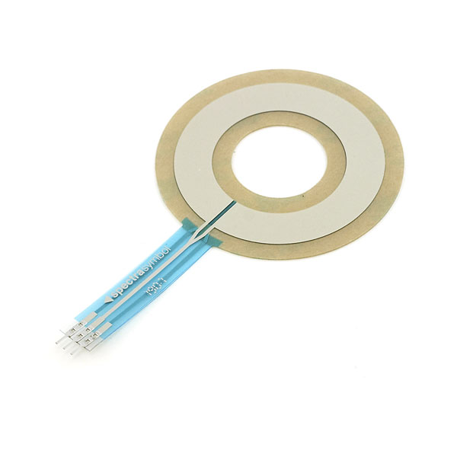
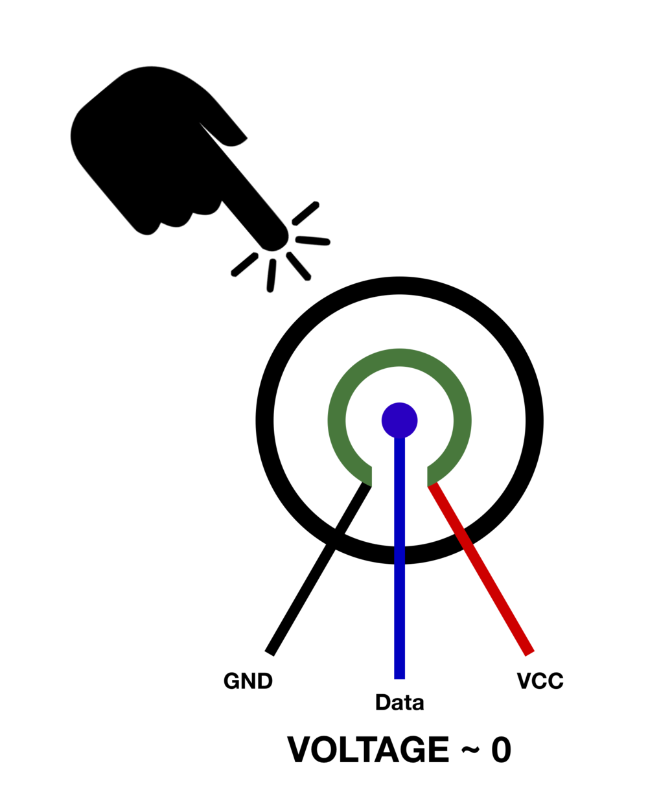
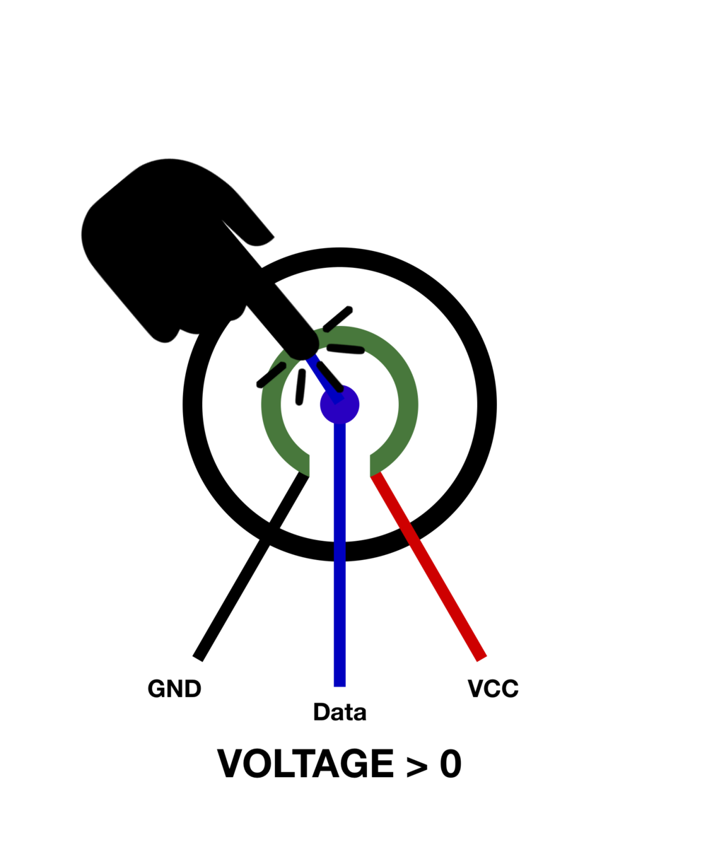
Circular Soft Potentiometer
The SoftPot uses touch to connect the internal resistance to the data pin within the potentiometer. We can think of it as a varying resistance connected in a voltage divider. If we have no contact with the SoftPot, we get close to 0 V running through the data pin:
Depending on the touch location, the resistance of the membrane will change, therefore resulting in a change in voltage (in the case of Arduino, from 0V - 5V). A touch can be visually modeled as shown below:

Slide 18
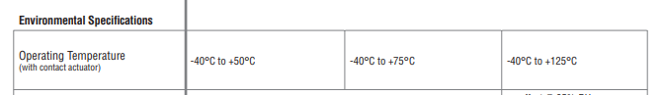
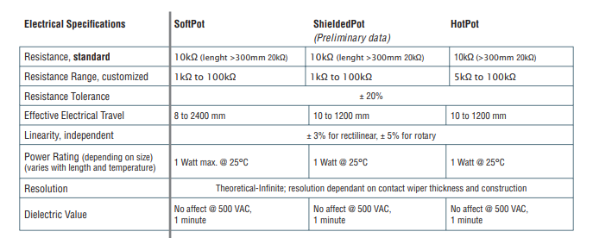
Data sheet

Slide 19
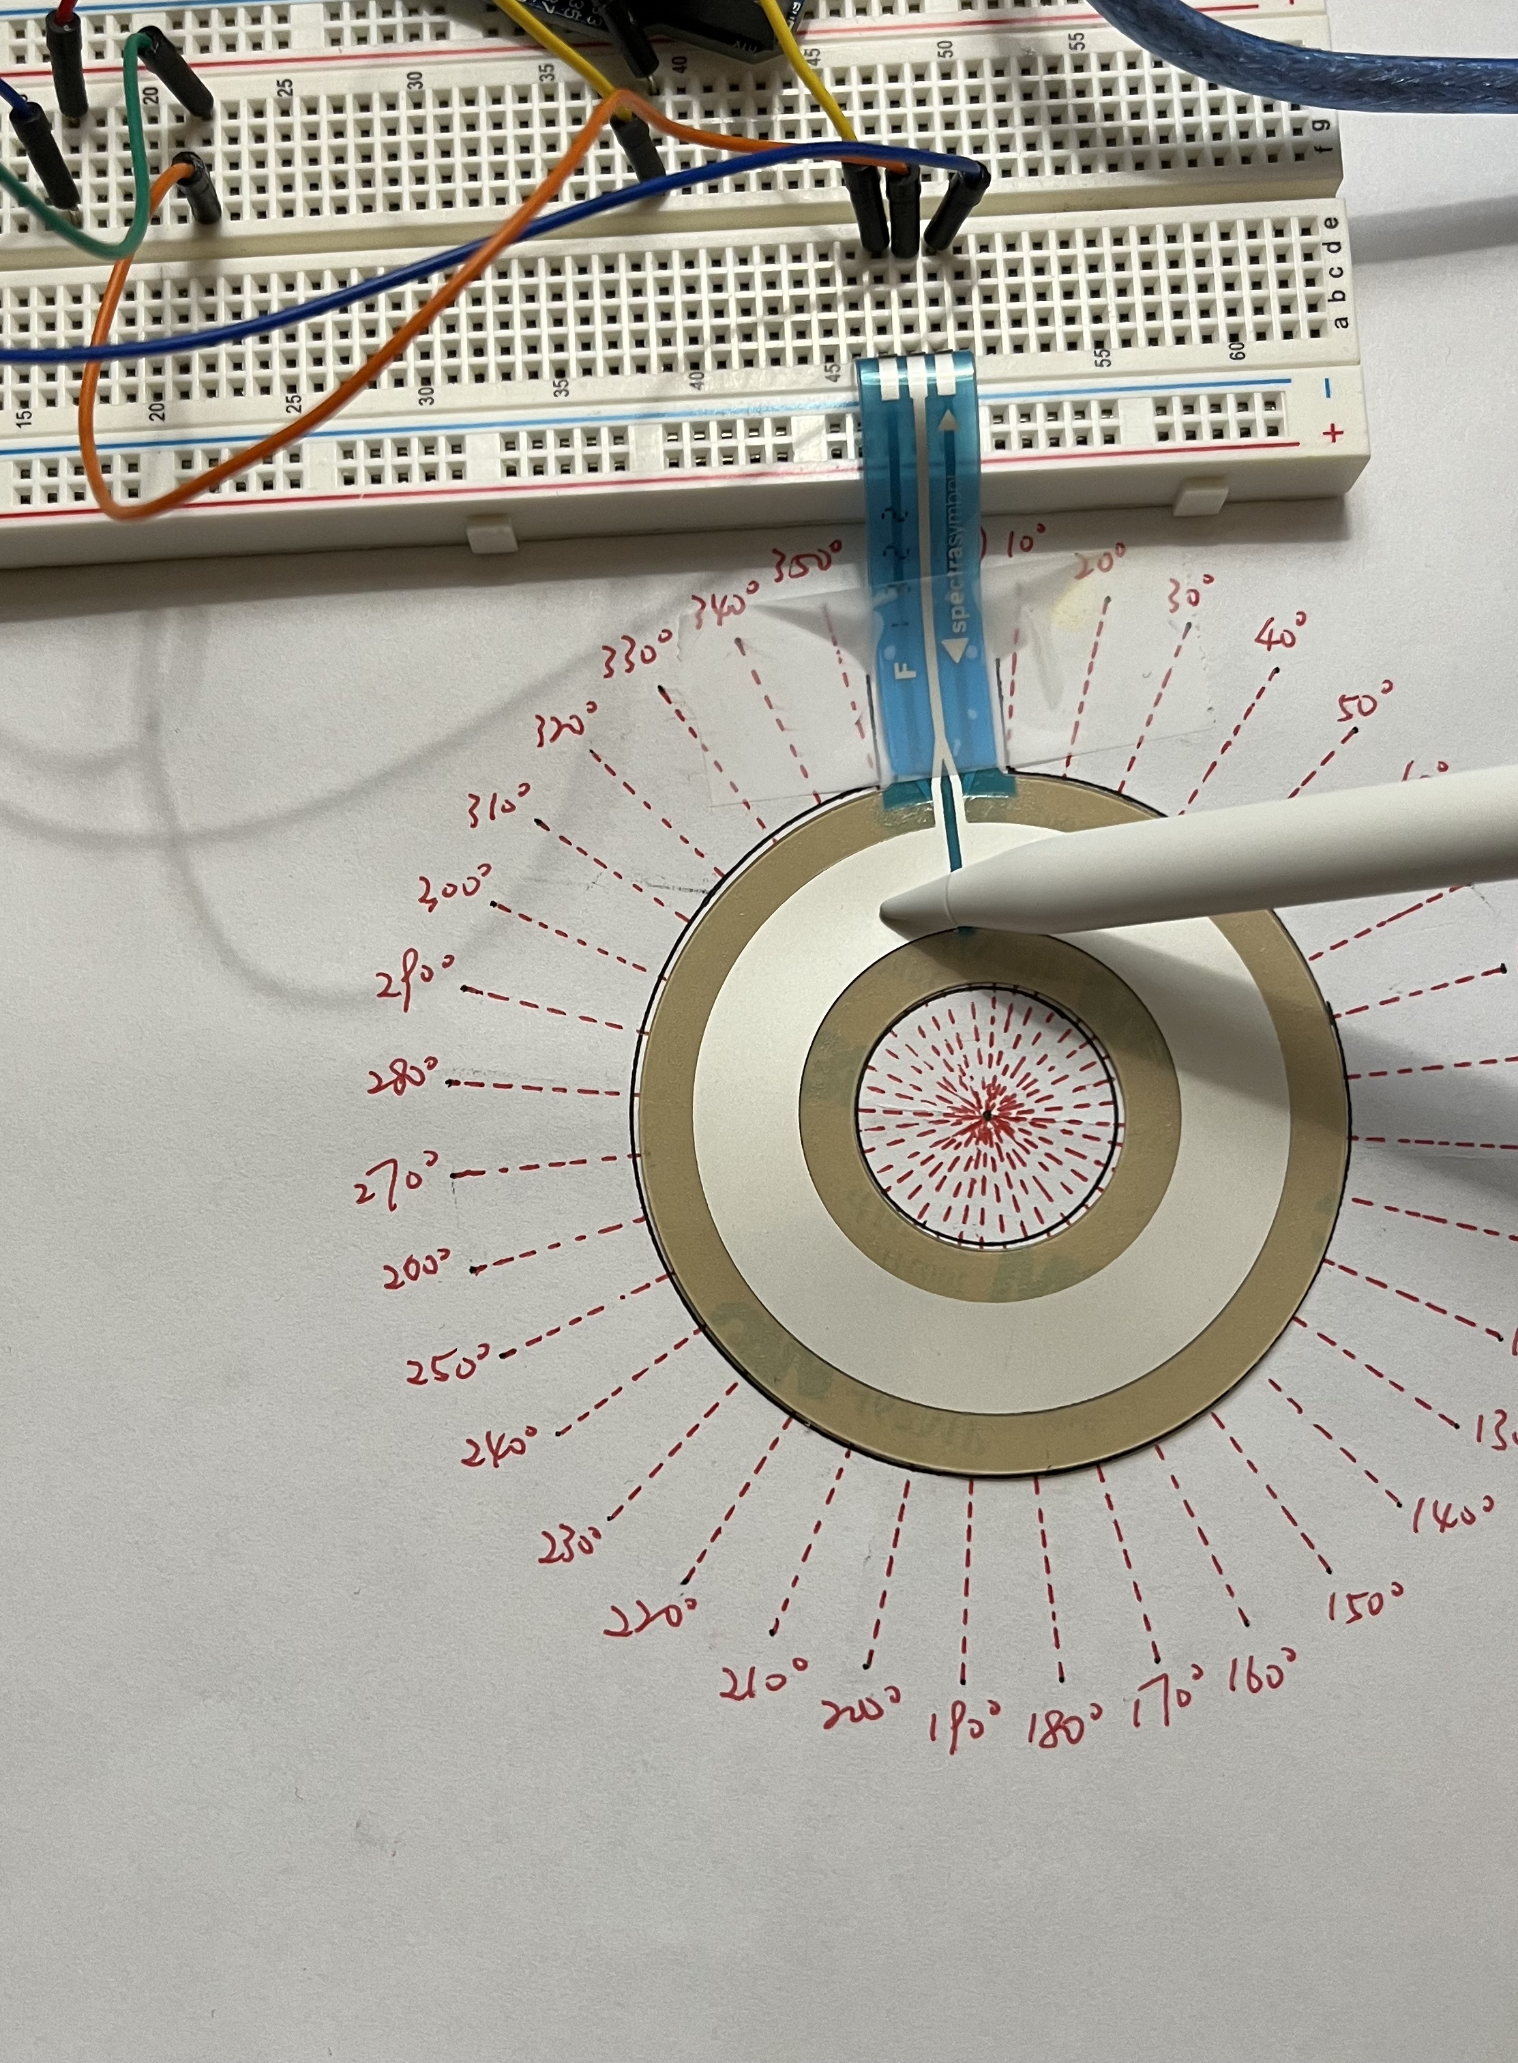
Testing plan
Accuracy: Error between actual measured angle and Arduino displayed measured angle.
Equipment: protractor, Arduino.

Slide 20
Accuracy
Circle
Angle(º) | 1 | 2 | 3 | Average Measurement(º) | Error
30 | 21.11 | 20.06 | 20.76 | 20.64 | -31.19%
60 | 58.06 | 58.42 | 58.77 | 58.42 | -2.64%
90 | 92.55 | 92.55 | 92.9 | 92.67 | 2.96%
120 | 122.82 | 123.87 | 123.17 | 123.29 | 2.74%
150 | 157.3 | 156.25 | 155.54 | 156.36 | 4.24%
180 | 188.27 | 188.62 | 187.92 | 188.27 | 4.59%
270 | 274.49 | 275.54 | 275.19 | 275.07 | 1.88%
360 | 360 | 360 | 360 | 360.00 | 0.00%
Notes:
This set of data is the most happy data among my three sensors, and the error of the data is reasonable except for the first data.
We can see that except for the first set of data, all the other data errors are within five percent.
The reason why the error of the first set of data is so large, I think it is caused by the poor electrical contact in that area.

Slide 21
Testing plan
Linearity: Get the plot of the data we measure. Then see weather the image is linear.
Equipment: protractor, Arduino.

Slide 22
Linearity
Notes:
As we can see it is almost linear.

Slide 23
conclusion
The Square FSR sensor can measure the weight of an object on the sensor, but it must be heavier than 100g that can be accurate.
The Long Flex/Bend Sensor can measure the degree of bending, but it is not recommended to measure large or small angles.
The Circular Soft Potentiometer sensor determines the position of applied pressure and is the most accurate of these three sensors.

Slide 24
That’s all Thank you!

